Slide 1
L01.02 Coding Cost model Document Distance
50.004 Introduction to Algorithm
Dr. Simon LUI
ISTD, SUTD

Slide 2
About the coding requirement of the course

Slide 3
coding requirement of this course
As I mentioned, you don’t need to do any coding
But we will be reading and understanding code / pseudo code
You need to read code in exam
E.g. read a code, tell me if it is O(n) or O(nlogn)

Slide 4
coding requirement of this course
What is pseudo code
if a is divisible by 3
print “OH YEAH”
What is code
if (a%3 == 0)
print “OH YEAH”;

Slide 5
How to read code and find its T(n)

Slide 6
How to read code
Print(“GREAT”);
T(n) = 1
i.e. the number of steps required to complete this program is 1
This code is Θ(1)

Slide 7
How to read code
Print(“GREAT”);
Print(“GREAT”);
Print(“GREAT”);
Print(“GREAT”);
T(n) = 4
i.e. the number of steps required to complete this program is 4
This code is Θ(1)

Slide 8
How to read code
For (i=0;i<5;i++)
Print(“GREAT”);
T(n) = 5
i.e. the number of steps required to complete this program is 5
This code is Θ(1)

Slide 9
How to read code
For (i=0;i<n;i++)
Print(“GREAT”);
T(n) = n
i.e. the number of steps required to complete this program is n
This code is Θ(n)

Slide 10
How to read code
For (i=0;i<n;i++)
For (i=0;i<n;i++)
Print(“GREAT”);
T(n) = n²
i.e. the number of steps required to complete this program is n²
This code is Θ(n²)

Slide 11
How to read code
For (i=0;i<n;i++)
For (j=0;j<n;j++)
Print(“GREAT”);
For (k=0;k<n;k++)
print(“GREAT”);
T(n) = n²+n
i.e. the number of steps required to complete this program is n²+n
This code is Θ(n²)

Slide 12
How to read code
For (i=0;i<n;i++)
For (j=0;j<n;j++)
Print(“GREAT”);
For (k=0;k<n;k++)
print(“GREAT”);
print(“GREAT”);
print(“GREAT”);
print(“GREAT”);
T(n) = n²+n+3
i.e. the number of steps required to complete this program is n²+n
This code is Θ(n²)

Slide 13
The cost model of code

Slide 14
Python cost model
L is a list
Commands | complexity (time)
L[i]=x | Θ(1)
L.append(x) | Θ(1)
L₁.extend(L₂) | Θ(|L₂|)
A = L₁+L₂ | Θ(|L₁|+|L₂|)
x in L | Θ(|L|)
Add x to L
Add L₂ to L₁
Add L₂ and L₁ to A
Search for x
D is a dictionary
Commands | complexity (time)
D[x_{i}]=y_{i} | Θ(1)
x in D | Θ(1)
X is index, y is value
Search for x

Slide 15
Document distance
Document means sequence of words
The Problem: Given 2 documents, find out how similar are they
The Algorithm: we will talk about it

Slide 16
Document distance - usage
1. detect plagiarism
2. Web update check
Simon loves iPhone. He wants to be the world first person to buy it
So he write a DOCUMENT DISTANCE code to check if the apple webpage has updated
If updated, probably there are new product.
So, send a email to notify Simon

Slide 17
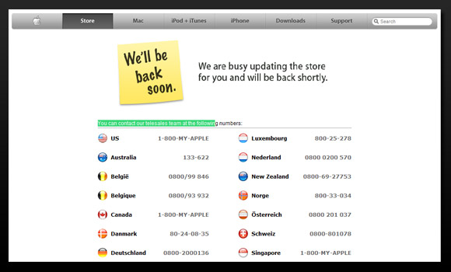

Document distance - usage
<!DOCTYPE html>
<html class="singapore sg nojs en en-sg apac" lang="en-SG">
<head>
<meta name="viewport" content="width=1024" />
<title>Pre-order iPhone 6s and iPhone 6s Plus - Apple (SG)</title>
<meta charset="utf-8" />
<meta http-equiv="X-UA-Compatible" content="IE=edge,chrome=1" />
<meta name="format-detection" content="telephone=no" />
<meta http-equiv="Set-Cookie" content="as_sfa=MnxzZ3xzZ3x8ZW5fU0d8Y29uc3VtZXJ8aW50ZXJuZXR8MHwwfDE=; path=/; domain=.apple.com; expires=Mon, 15-Sep-2025 04:18:11 GMT;" />
<meta property="og:type" content="product" />
COMPARE
<!DOCTYPE html>
<-equiv="X-UA-Compatible" content="IE=edge,chrome=1" />
<meta name="format-detection" content="telephone=no" />
<meta http-equiv="Set-Cookie" content="as_sfa=MnxzZ3xzZ3x8ZW5fU0d8Y29uc3VtZXJ8aW50ZXJuZXR8MHwwfDE=; path=/; domain=.apple.com; expires=Mon, 15-Sep-2025 04:18:11 GMT;" />
<meta property="og:type" content="product" />
<meta property="og:title" content="iPhone 6s" />
<meta property="og:url" content="http://www.apple.com/sg/shop/buy-iphone/iphone6s" />
<meta prope
Apple.com/iphone.html
…at 11:59am
Apple.com/iphone.html
…at 11:58am

Slide 18
Problem definition
Document D: sequence of words
Word w: sequence of characters
Word frequency D(w): number of occurrences of w in D
For example
D: “good morning good good”
w: {“good”, “morning”, “good”, “good”}
w[0] = “good”
w[1] = “morning”
w[2]= “good”
w[3] = “good”
D(“good”) = 3

Slide 19
What we will do today
I will show you some VERY COMPLICATED CODE
No need to understand them (out of syllabus)
I just want you to show you
the running time of O(1), O(n) and O(n²) function can be very different
How to improve the speed of a code

Slide 20
Algorithm for document distance - Vector space model
Treat each document as a vector of its words
– one coordinate per word of the English dictionary
e.g.
doc1 = “the cat”
‘dog’
doc2 = “the dog”
1
The dot product between D1 and D2
represent their similarity
‘the’
1
1
‘cat’
d1
d2 = 1

Slide 21
Algorithm for document distance - Vector space model
e.g.
“the cat”。”the dog”
= [the x the + cat x dog]
= 1 + 0
= 1

Slide 22
Algorithm for document distance - Vector space model
e.g.
“the the cat cat”。”the the dog dog”
= the x the + the x the + cat x dog + cat x dog
= 1 + 1 + 0 + 0
= 2

Slide 23
Algorithm for document distance - Vector space model
… wait,
A: “the cat” vs “the dog”
B: “the the cat cat” vs ”the the dog dog”
Both problem A and B are 50% similar. Why B score more (2) than A (1)?
So, we need to normalize the result

Slide 24
Algorithm for document distance - Vector space model
e.g.
[“the cat”。”the dog”] / sqrt(2 x 2)
= [the x the + cat x dog] / 2
= [1 + 0] / 2
= 50%

Slide 25
Algorithm for document distance - Vector space model
e.g.
[“the the cat cat”。”the the dog dog”] / sqrt(4 x 4)
= [the x the + the x the + cat x dog + cat x dog] / 4
= [1 + 1 + 0 + 0]/4
= 50%

Slide 26
Vector space model
Normalization
divide by the length of the vectors
measure distance by angle between vectors:
e.g. θ=0 documents “identical” (if of the same size, permutations of each other)
θ=π/2 not even share a word

Slide 27
Algorithm
aabcvbnlbgbaanlaaubaanlcvbxfeof
[aa,cv] + [bg,aa] + [au,aa] + [cv,xf]
Read file
Make word list (divide file into words)
Count frequencies of words
Compute dot product
for every word in the first document, check if it appears in the other document; if yes, multiply their frequencies and add to the dot product
worst case time: order of #words(D₁) x #words(D₂)
micro-optimization:
sort documents into word order (alphabetically)
compute inner product in time #words(D₁) + #words(D₂)
[aa, cv, bg, aa, aau, aa, cv,xf]
[(aa,3), (cv,2), (bg,1), (aau,1),(xf,1)]
[(aa,3), (aau,1), (bg,1), (cv,2)]
[(aa,2), (ba,2), (bg,2), (ca,1), (fv,2)]

Slide 28
Python Implementation
b=blank char
nl=new line char
eof = end of file char
Docdist1.py (see handout)
Read file: read_file(filename)
– Output: list of lines (strings)
• Make word list: get_words_from_line_list(L)
– Output: list of words (array)
• Count frequencies: count_frequency(word list)
– Output: list of word‐frequency pairs
• Sort into word order: insertion_sort()
– Output: sorted list of pairs
• Dot product: inner_product(D1, D2)
– Output: number
aabcvbnlbgbaanlaaubaanlcvbxfeof
aabcv , bgbaa , aubaa , cvbxf
[aa,cv] , [bg,aa] , [au,aa] , [cv,xf]
[aa, cv, bg, aa, aau, aa, cv,xf]
[(aa,3), (cv,2), (bg,1), (aau,1),(xf,1)]
[(aa,3), (aau,1), (bg,1), (cv,2)]
[(aa,2), (ba,2), (bg,2), (ca,1), (fv,2)]

Slide 29
cProfiling.run()
return T(n)
– import profile
– profile.run(“main()”)

Slide 30
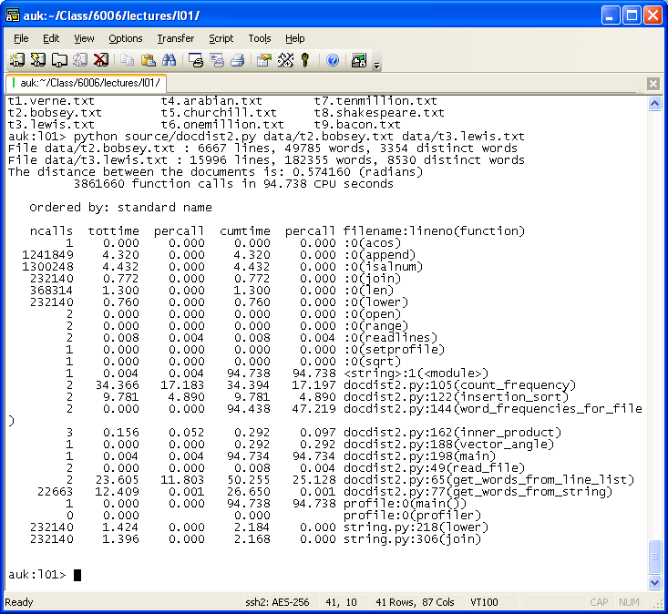

Slide 31
docdist1
Docdist1.py is slow
Docdist2.py is faster
Docdist3.py is even faster
….
Docdist8.py is the best
Now let’s look at docdist1.py

Slide 32
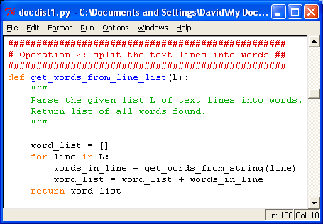

Slide 33

+ is slow, need to improve it
Look at word_list = word_list + words_in_line
+ : concatenation of arrays
running time = T(k)
k = length (word_list) + length(words_in_line)
Total T(n) is 1+2+…+n = n(n+1)/2 = Θ(n²)

Slide 34
Solution
word_list = word_list + words_in_line: Θ(n²)
docdist1.py (3.7s)
word_list.extend(words_in_line) : Θ(n)
docdist2.py (2.722s)
How to run:
Python docdist1.py file5.txt file4.txt

Slide 35
Further Improvements
Docdist3.py: sort the data first (2.657s)
Docdist4.py: Instead of inserting words in list, insert in dictionary: (0.735s)
Docdist5.py: Process words instead of chars (0.138s)
Docdist6.py: better sorting algorithm (0.069s)
merge sort instead of insertion sort)
Docdist7.py: dictionary instead of sort. (0.052s)

Slide 36
Appendix – my mindset of optimizing the code

Slide 37
docdist<1-8>.py – Iterative improvements
Objective
To arrive at the most efficient implementation in terms of running time
Approch
At each iteration, analyze the running times of various parts of the code
Based on the biggest consumer of running time, refactor the code by
Introducing faster algorithms
Using features of the Python language
Simplifying and optimizing code

Slide 38
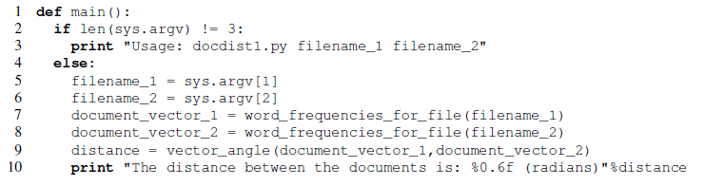
docdist1 – Code structure

Slide 39
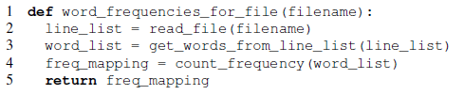
docdist1 – Code structure

Slide 40
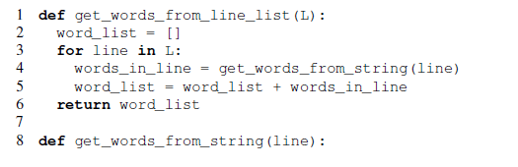
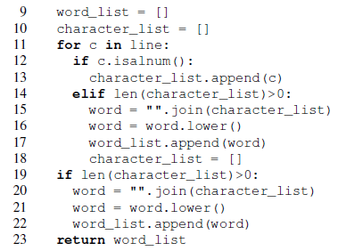
docdist1 – Code structure

Slide 41
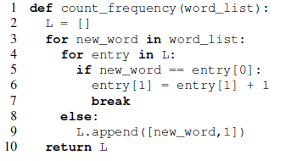
docdist1 – Code structure

Slide 42

docdist1 – Code structure

Slide 43
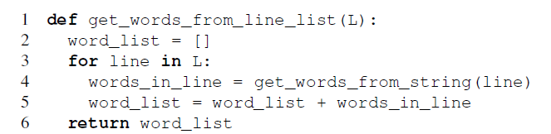
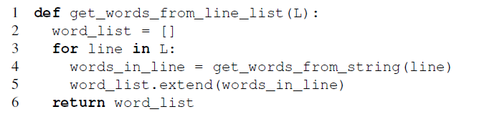
docdist1 vs. docdist2

Slide 44
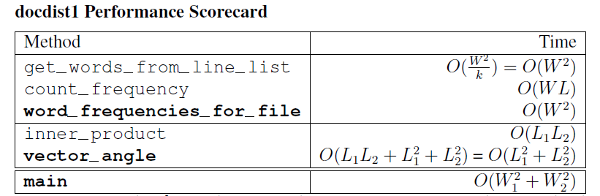
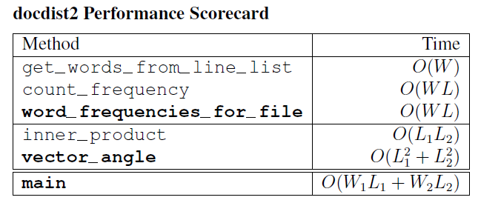
docdist1 vs. docdist2

Slide 45
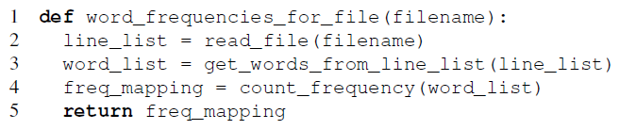
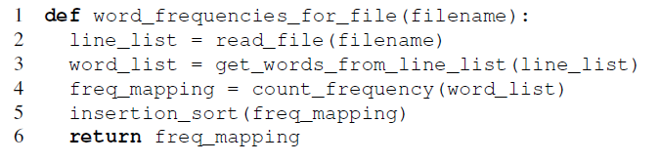
docdist2 vs. docdist3

Slide 46
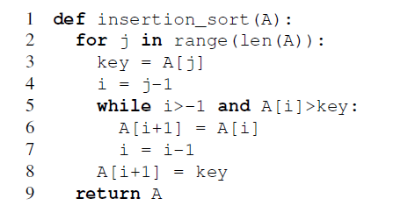
docdist3 – Implementing insertion_sort()

Slide 47
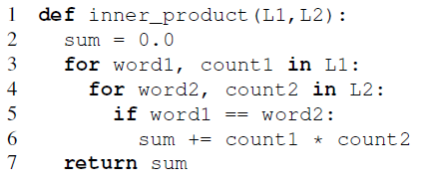
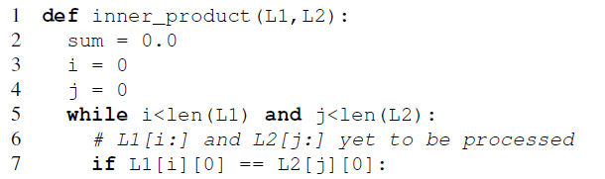
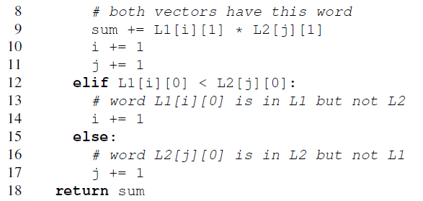
docdist3 - Reimplementing inner_product()

Slide 48
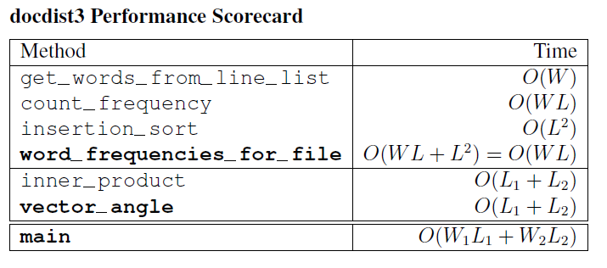
docdist2 vs. docdist3

Slide 49
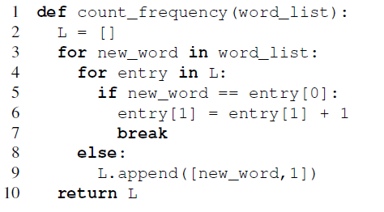
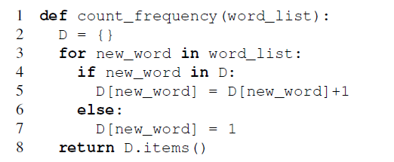
docdist4 – Refining count_frequency()

Slide 50
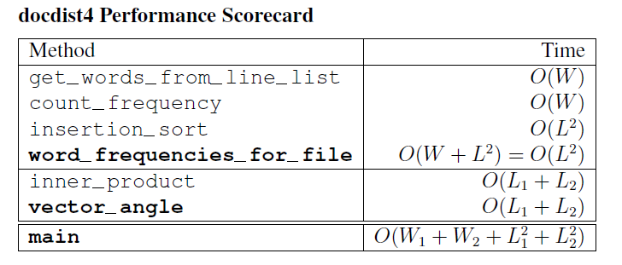
docdist3 vs. docdist4

Slide 51
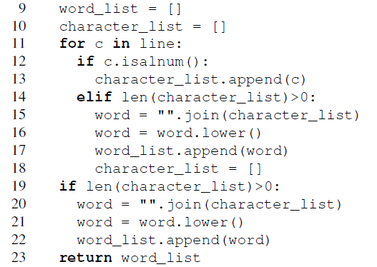
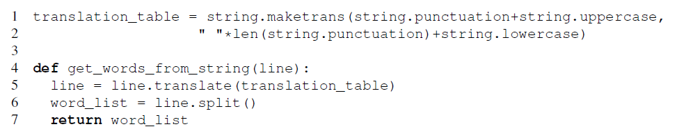
docdist5 – Simplifying get_words_from_string()

Slide 52
docdist4 vs. docdist5 (same as docdist4)

Slide 53
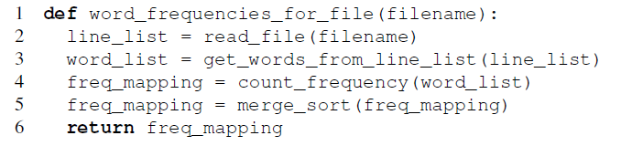
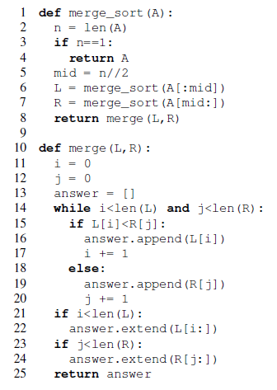
docdist6 – Replacing insertion sort by merge sort

Slide 54
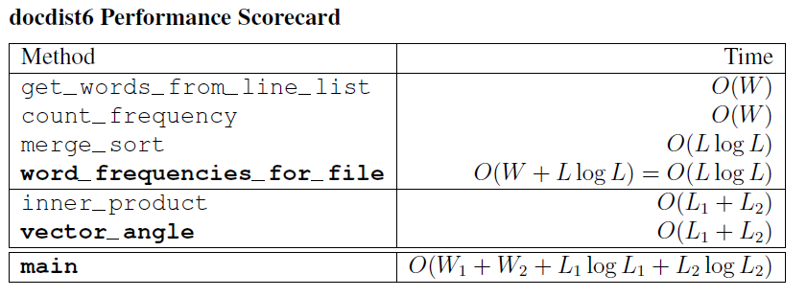
docdist5 vs. docdist6

Slide 55
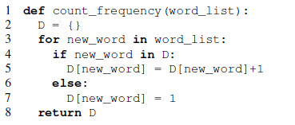

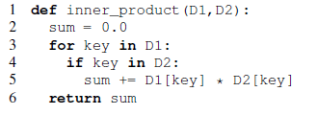
docdist7 – From sorted list to document vectors

Slide 56
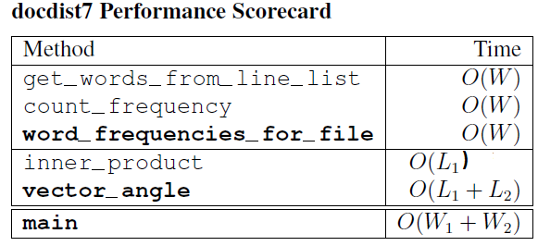
docdist6 vs. docdist7

Slide 57
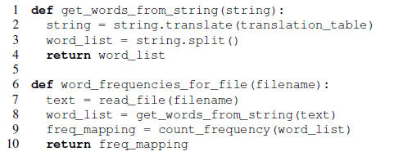
docdist8 – Simplifying the code

Slide 58
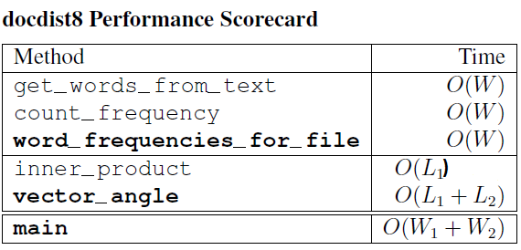
docdist7 vs. docdist8

